Slide 1
The Debate on Art and Craft
Similarities between art and craft
Both involve creating
Problem solving
Composition
Design decision
Pattern recognition

Slide 2
According to one perception art and craft can only be determined by exhibiting the work and what it means out and before the public especially through galleries, museums and publications.

Slide 3
When we judge craft or art to be high or low this opinionated stance stunts the economic, democratic, social and cultural growth of a craftsperson.
The definition of design, craft and art over the last two hundred years have changed and so has their status in the domain of art and craft. Craft is now occupying an integral position within fine art, fashion, architecture and industrial design.

Slide 4
In Australia craft of exceptional quality of workmanship, uniqueness and refinement show a degree of problem solving, creative intelligence and innovation is classed as “Art Craft”.

Slide 5
In the USA the same creation is called ‘Fine Craft”.
In the UK there is no distinction in the craft. Everything is lumped together

Slide 6
Part of the problem with defining an object as “Fine Craft” or “Art: is that the object may be defined as merely everyday handiwork in one decade and may be praised as art or fine craft in the next. Like The Gee Bend quilts shown above. Made in Australia

Slide 7
In 1970s new craft had become so integrated with art and indistinguishable from it that they no longer existed as art. An article called “The Concept of Craft” was published the same year. It asked three major questions:

Slide 8
Another artist who played an integral role in defining art was Marcel Duchamp who placed a urinal in an art gallery and hence questioned whether a piece of commercial ceramic could be termed as art if its environ was changed from the toilet to an art gallery.

Slide 9
Whether Mr. Marcel made the fountain with his own hands or not has no importance. He Chose it.
He took an article of life, placed it so that its useful significance disappeared under the new title and point of view – created a new thought for that object

Slide 10
Crafts of sindh

Slide 11
Crafts Of Sindh
Blue Pottery of Halla
Kashi on tiles
Kashi on pottery
Kashi on wood
Susi
Ajrak
Ralli
Sindhi topis

Slide 12
Hala Pottery
Blue pottery of Hala is very famous.
Hala is a town 30 km from Hyderabad

Slide 13
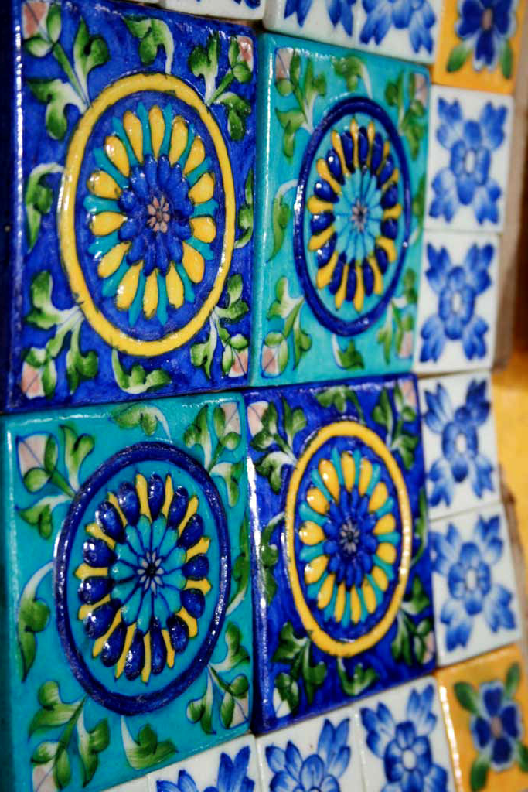
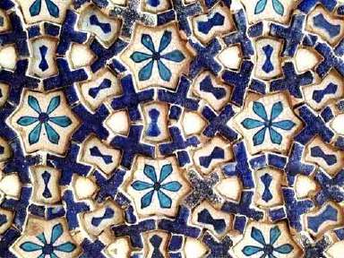
Painting on tiles, wood and pottery known as Kashi

Slide 14
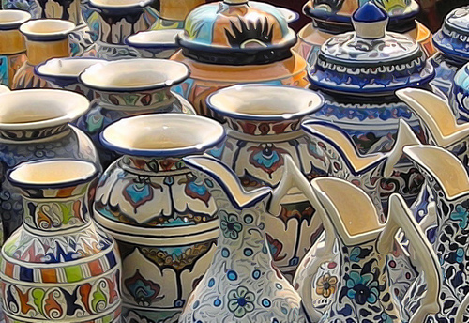
Kashi
Kashi on pottery
Kashi on wood

Slide 15
Susi – A fabric made in Sindh

Slide 16
A mobile phone carrier made of Susi

Slide 17
Typical Ajrak patterns and colors

Slide 18
Ajrak used on cushions and bed spread as well
Ajrak in contemporary use

Slide 19
Ralli Patchwork quilt

Slide 20
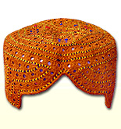
Sindhi Topis

Slide 21
Crafts of PUNJAB

Slide 22
Crafts of Punjab
Phulkari
Wood work
Wooden architecture of Chiniot
Truck art
Khussa
Piris
Parandis
Lungi
Rag dolls
Jewelry of Punjab
Gota Kinari of Multan
Basketry

Slide 23
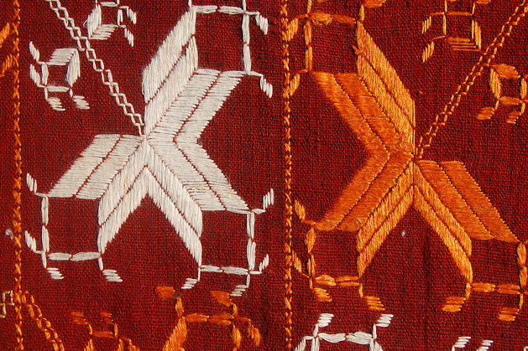
Phulkari

Slide 24
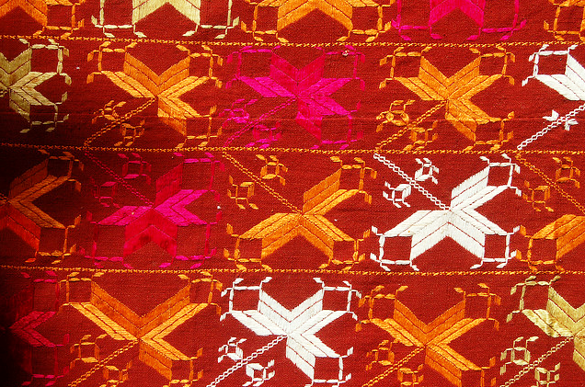

Slide 25
Wedding Phulkari given in dowry and stitched by household women

Slide 26
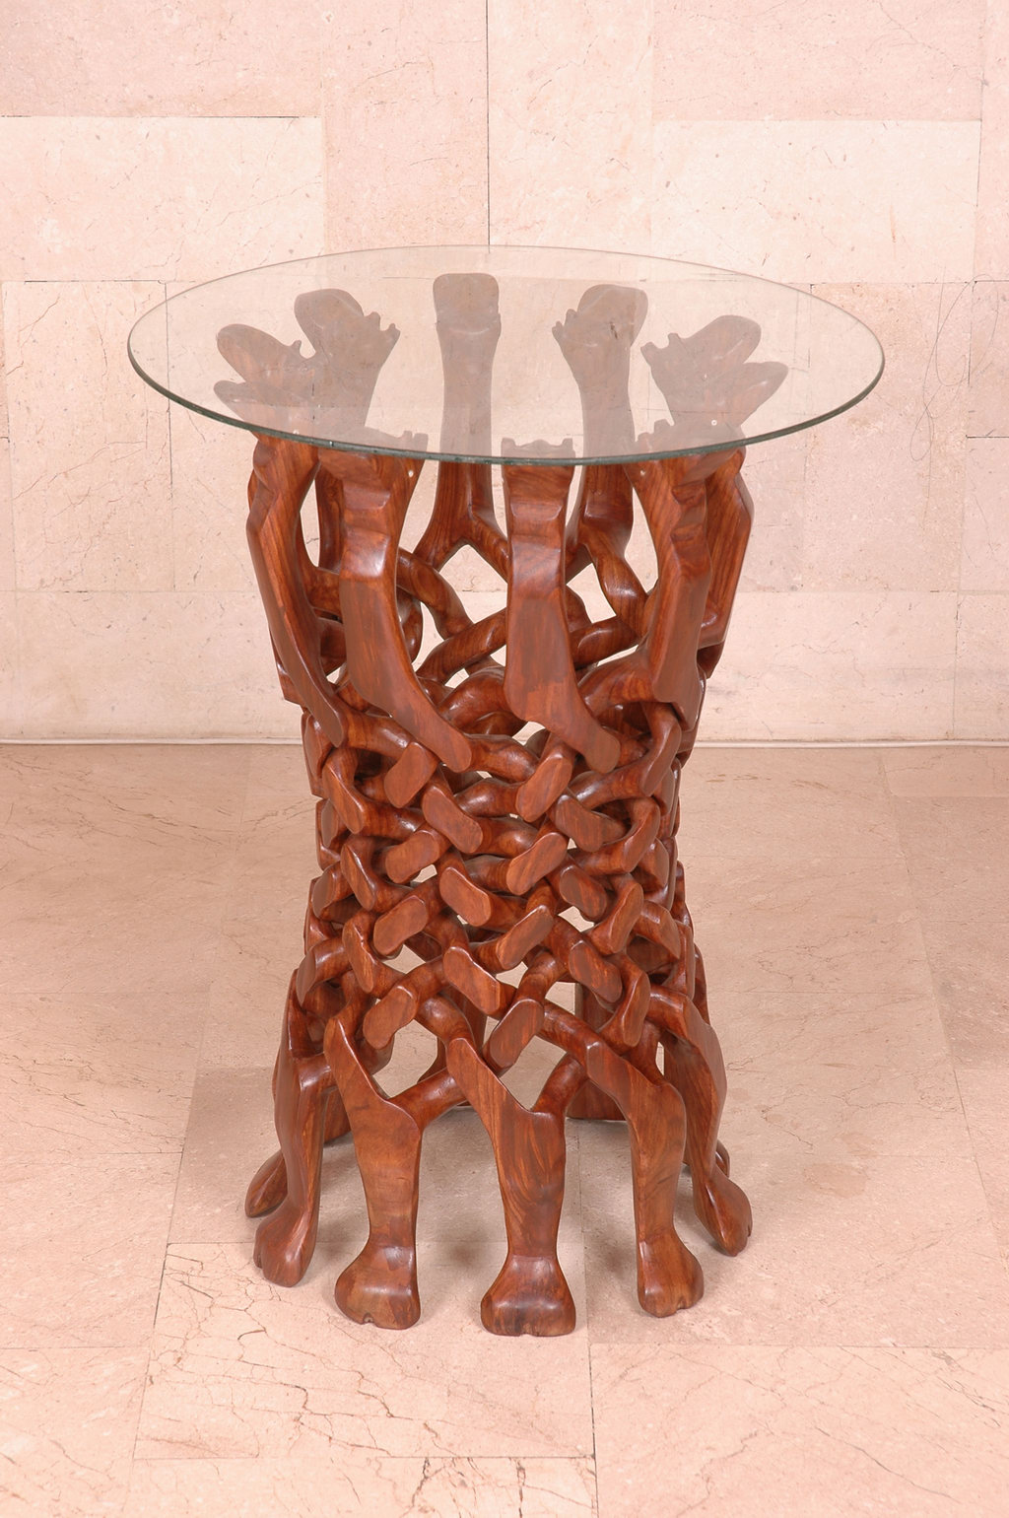
Wood work
Wooden inlay box
WOODEN BOX WITH BRASS INLAY
HAND CARVED

Slide 27
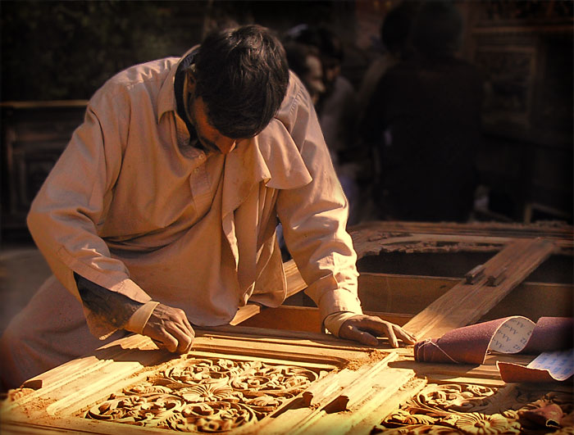

Slide 28
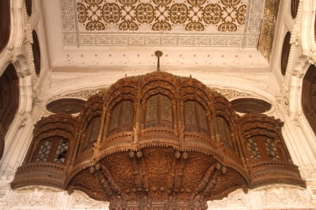
Wooden Craft In Architecture

Slide 29
Wood Craft In Truck Art

Slide 30
Khussas of Punjab

Slide 32
Piris of Punjab

Slide 33
Parandis made in Punjab

Slide 34
Rag Dolls Made In Punjab

Slide 35
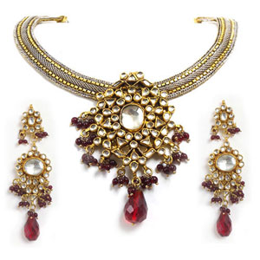
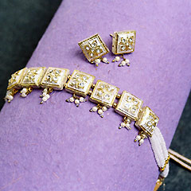
Traditional jewelry made in Punjab

Slide 36
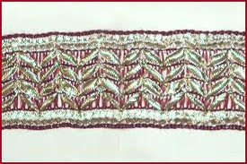
Gota Kinari is done on women's garment in Multan

Slide 37
Basketry

Slide 38
Crafts of KHYBER PAKHTOONKHWA

Slide 39
Craft of NWFP
Brass work of Peshawar
Peshawari Chappal
Pashtun Woolen carpets
Woodwork of NWFP
Kasheeda
Namda
Gabbah

Slide 40
Brass work of Peshawar

Slide 41
Peshawari Chapals

Slide 42
Pashtun woolen carpets woven on special looms called Kady

Slide 43
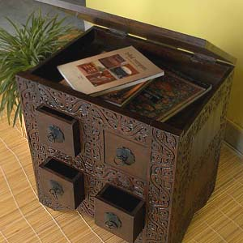
Wood Work of NWFP

Slide 44
A jumlo is an elaborately decorated, knee length dress from Kohistan in the North West Frontier Province (NWFP) of Pakistan. Jumlos are normally made from black cotton. The dress is made in three main parts, the bodice; long and wide sleeves, and a full skirt.

Slide 45
Kasheeda Is embroidery done in gold and silver on women attires

Slide 46
Namda
A worker stitching a Namda

Slide 47
NUMDA PATTERNS IN CONTEMPORARY DESIGNS

Slide 48
Two different kinds of Gabbeh

Slide 49
Crafts of baluchistan

Slide 50
Crafts of Baluchistan
Mirror Work
Baluchi Garments
Patch work
Leather work
Afghan Rug
Stone work
Gujj

Slide 51
Mirror work in embroidery
Elaborate mirror work on a Balochi blouse
Elaborate mirror work on a Balochi cushion

Slide 52
Mirror work in embroidery
A traditional Balochi garment with embroidery and mirror work on it.
Traditional Balochi garment with indigenous embroidery on it

Slide 53
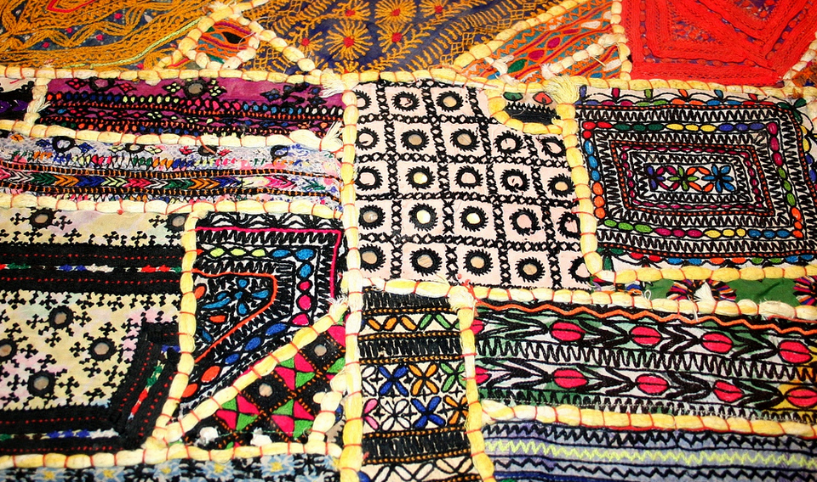

Slide 54
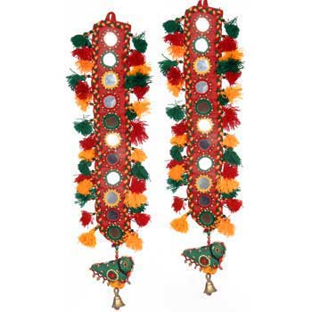
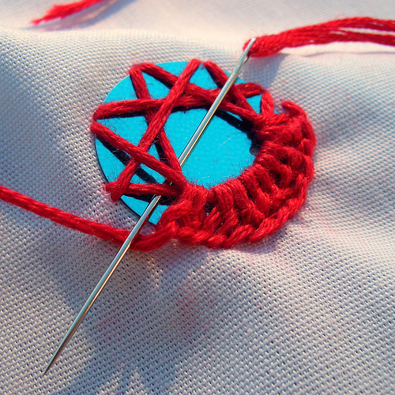

Slide 55
Leather Craft
Leather CHAPPALS made in Baluchistan
Embroidery on leather cap

Slide 56
Rugs
Afghan style Balochi rugs depicting war scenes
Afghan style rugs made in Baluchistan

Slide 57
Balochi rugs in Afghan style

Slide 58
Stone Work
ONYX work in Baluchistan

Slide 59
Gujj

Slide 60
CRAFTS OF KASHMIR
Pashmina Shawls
Carpets
Chain Stitch Rugs

Slide 61
Kashmiri shawls

Slide 65
Kashmiri carpets

Slide 68
Kashmiri chain stitched rugs

Slide 73
CRAFTS OF SINDH
Ajrak
Ralli
Kashi work(tiles)
Sindhi embroidery

